Slide 1
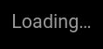

Slide 3
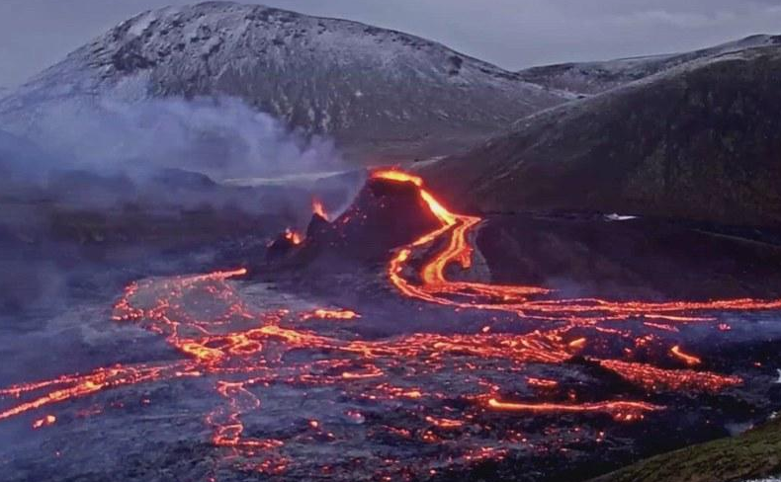
Volcanic Eruptions
Tristan Mercier
By: Tristan

Slide 4
Introduction
Negative/Positive Effects on
economy, people, and environment.

Slide 5
Negative

Slide 6
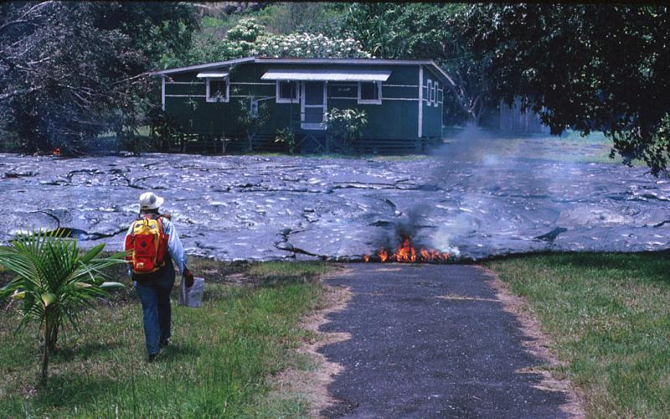
Notes:
Talk about how it damages people's houses and other structures.

Slide 7
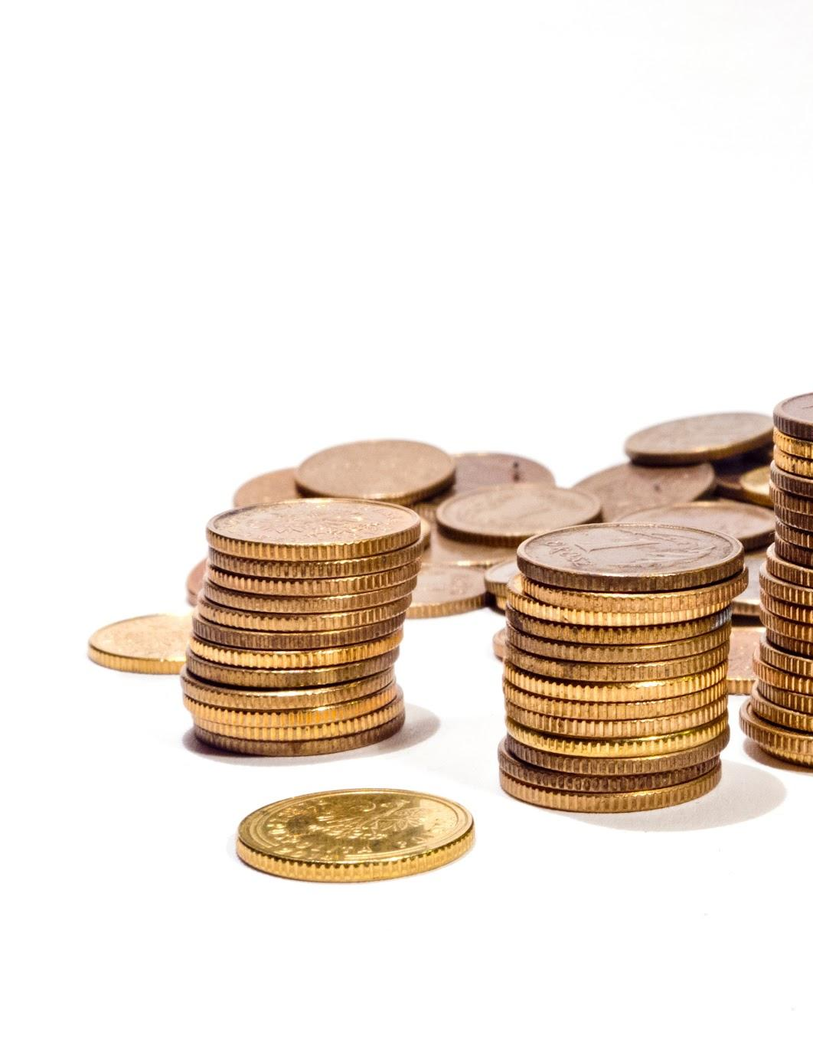
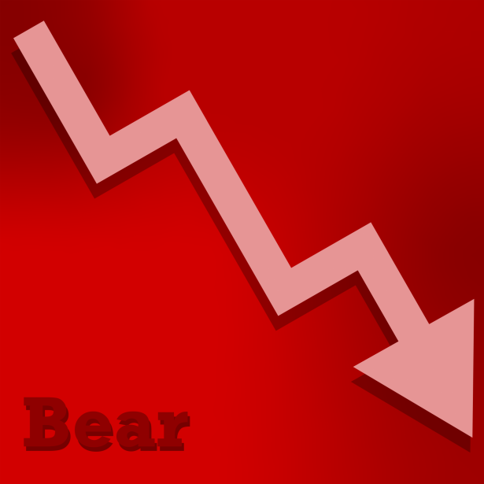

Slide 8
$1,000,000,000

Slide 9
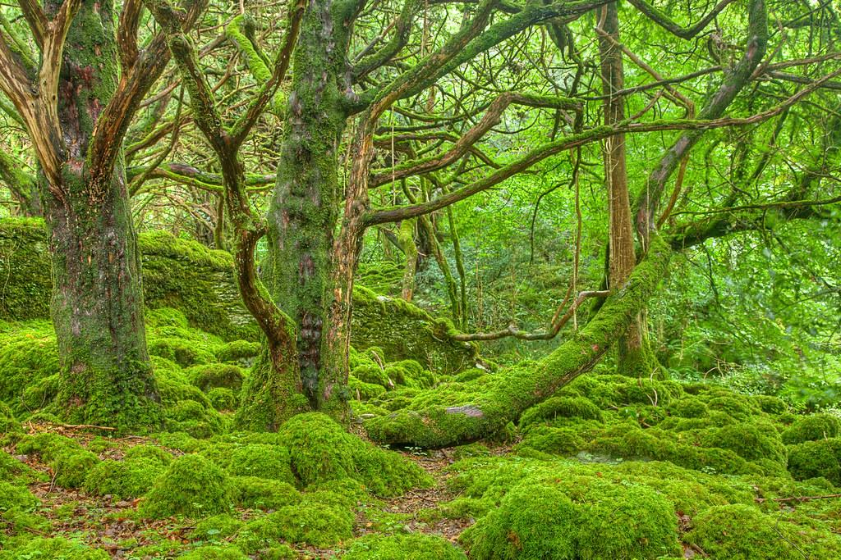
Notes:
Talk about how it harms the environment

Slide 10
Positive

Slide 11
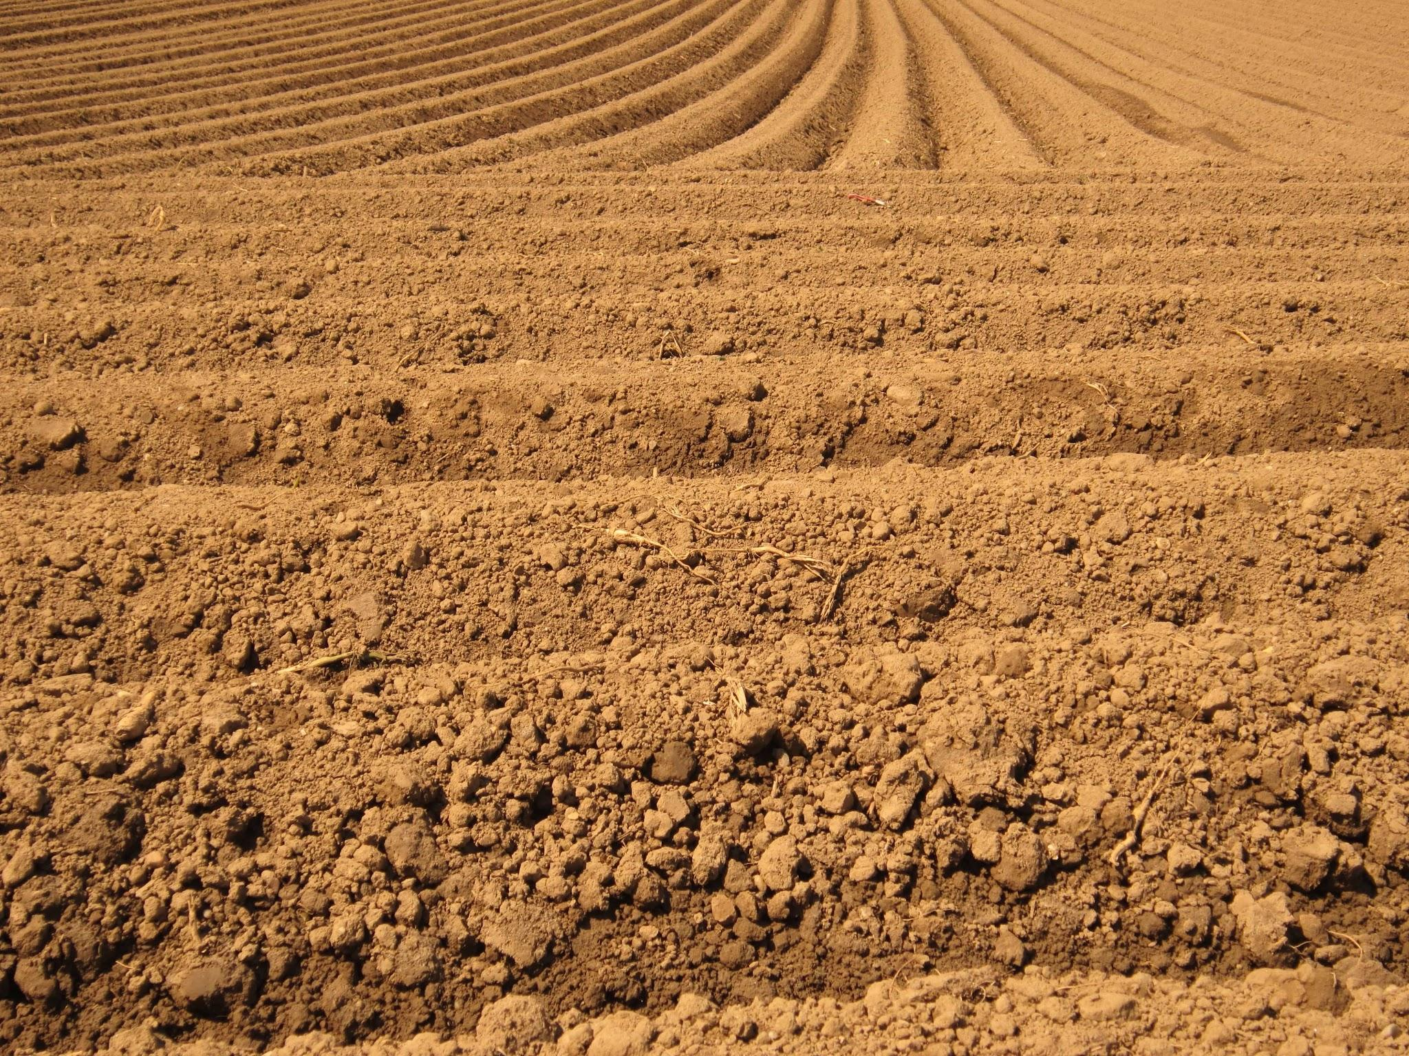
Fertile Soil

Slide 12
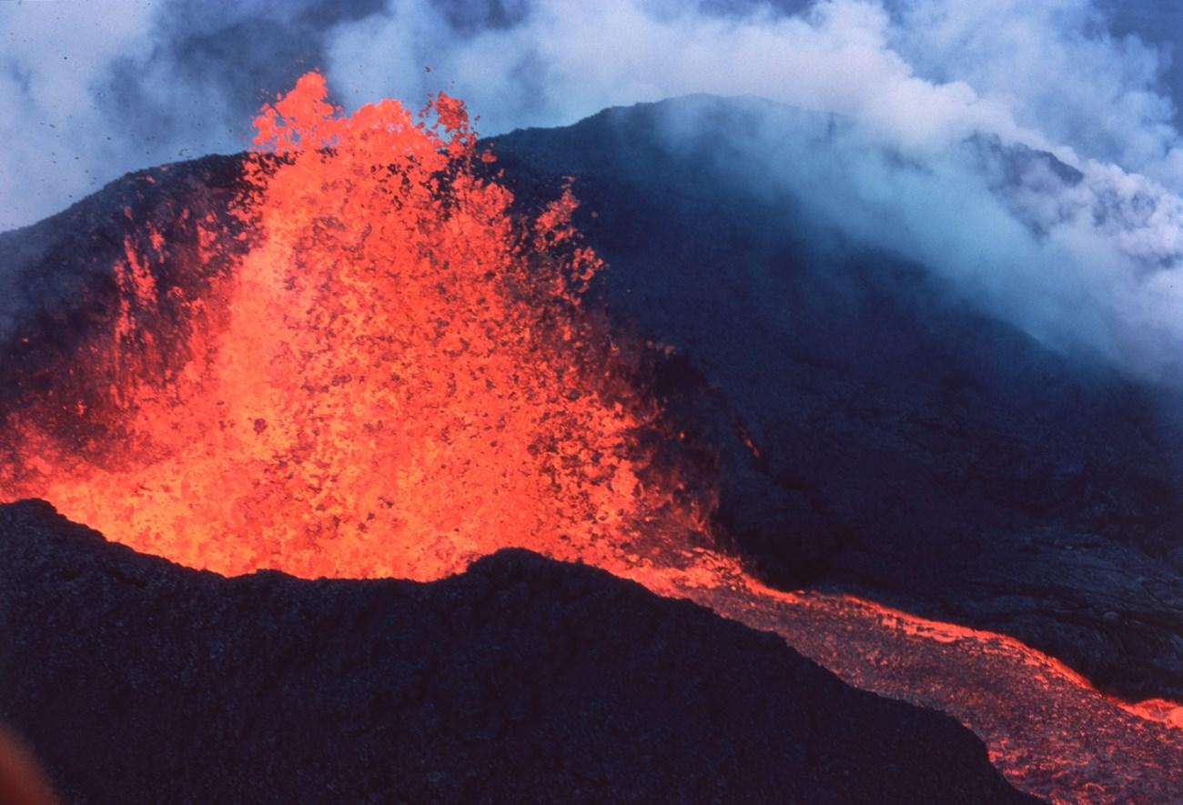

Slide 13
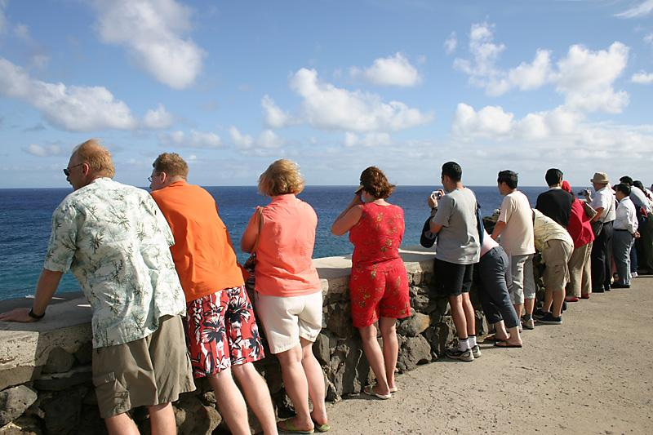

Slide 14
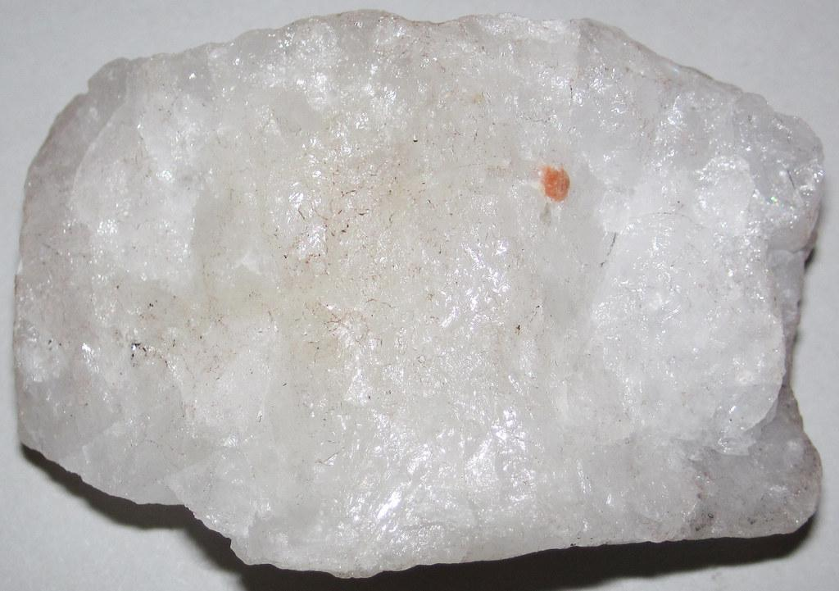

Slide 15
Other/Facts

Slide 16
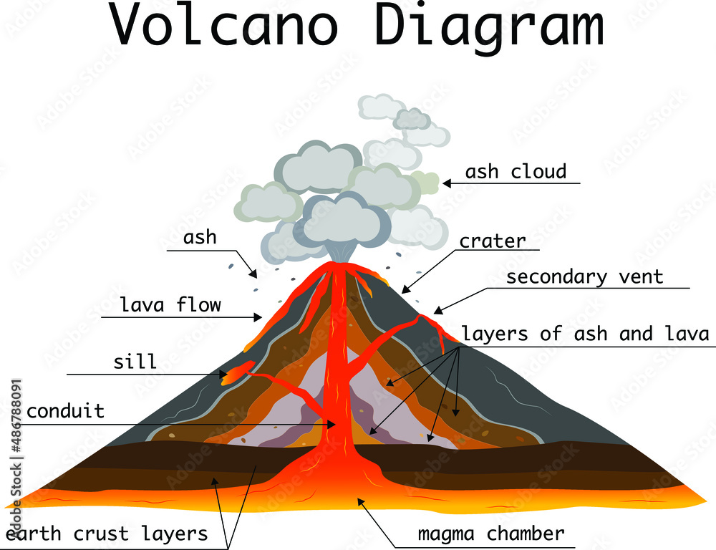

Slide 17
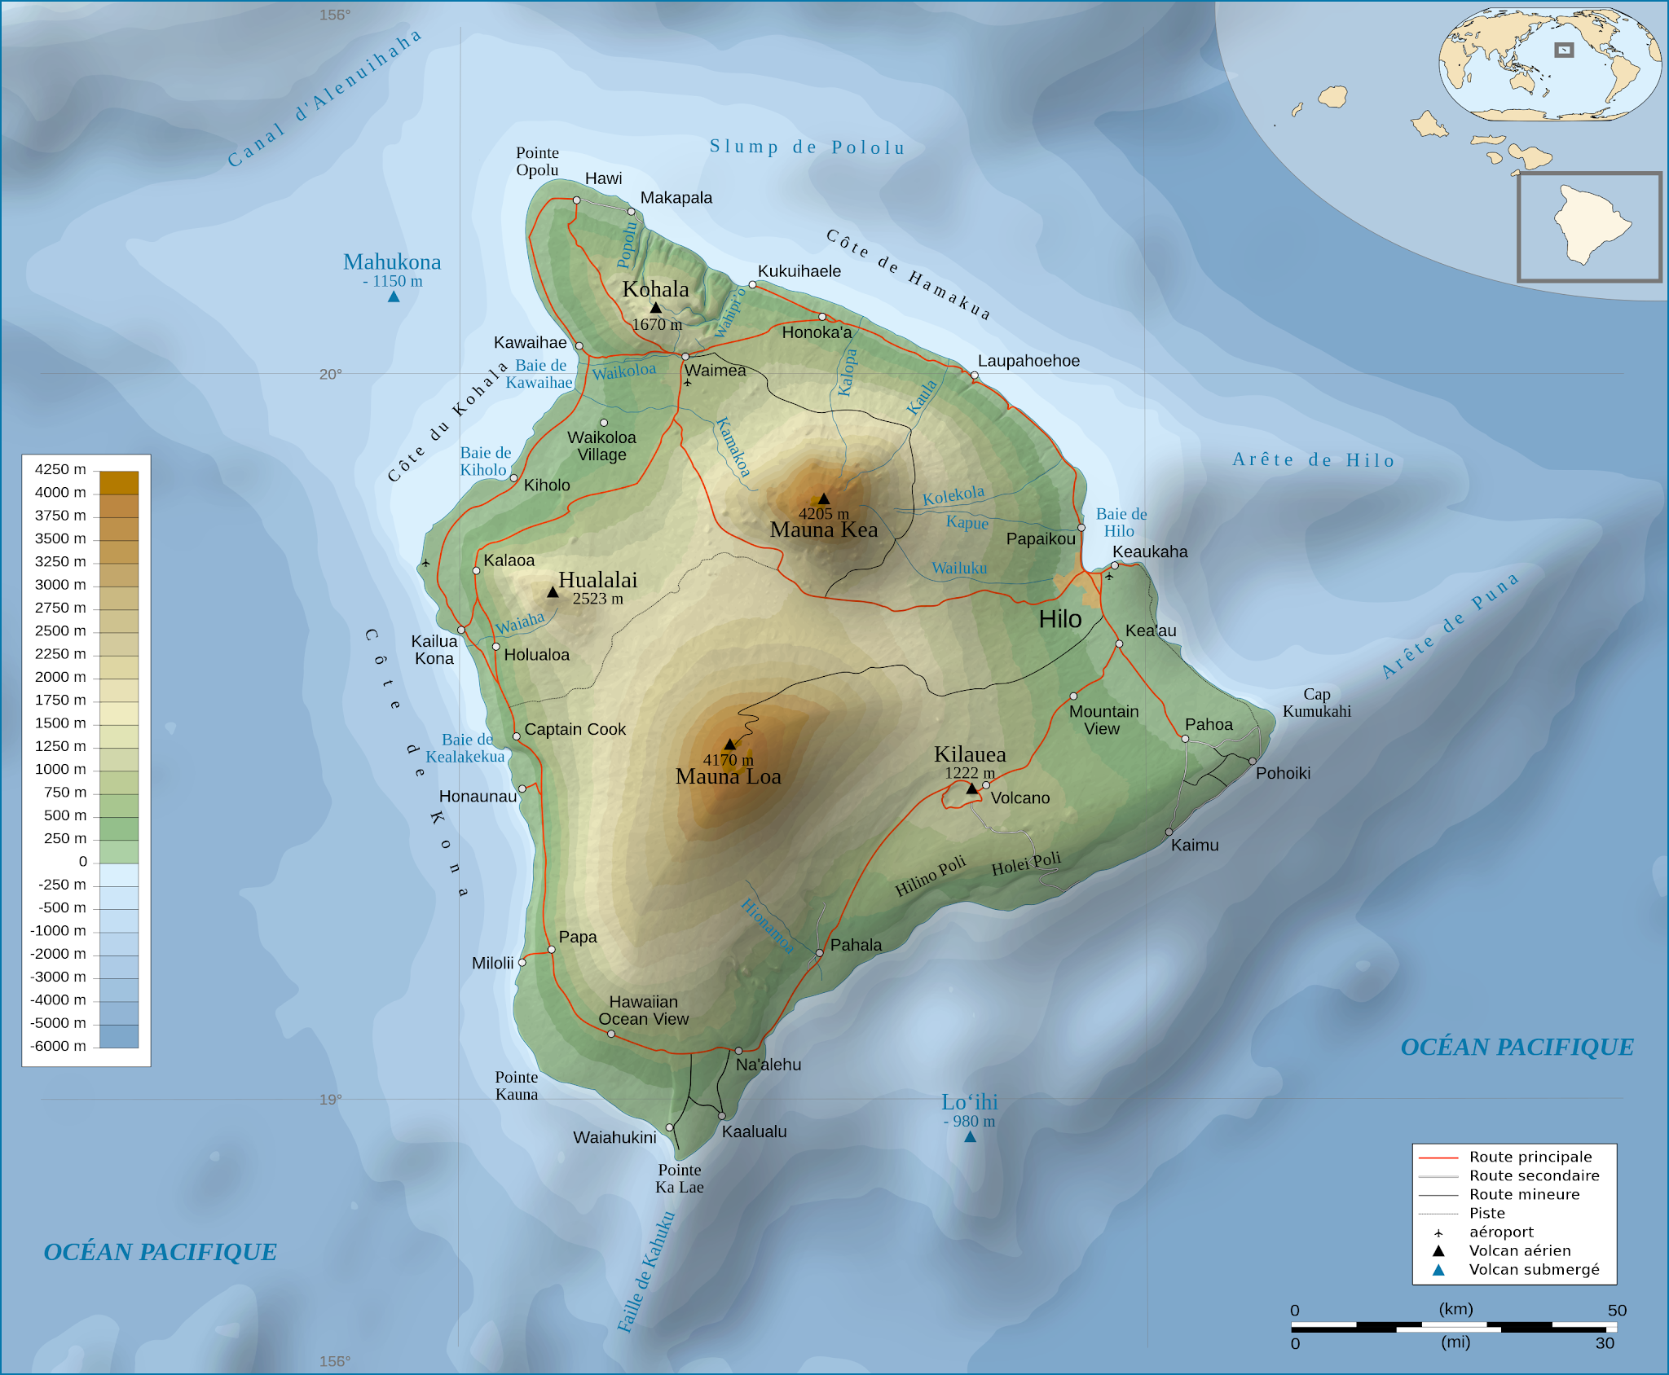

Slide 18
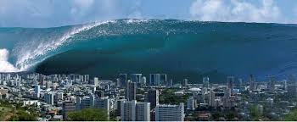

Slide 19
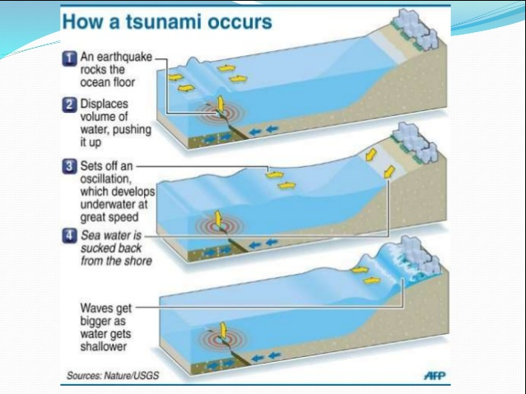

Slide 20
1000

Slide 21
Any Questions?

Slide 22
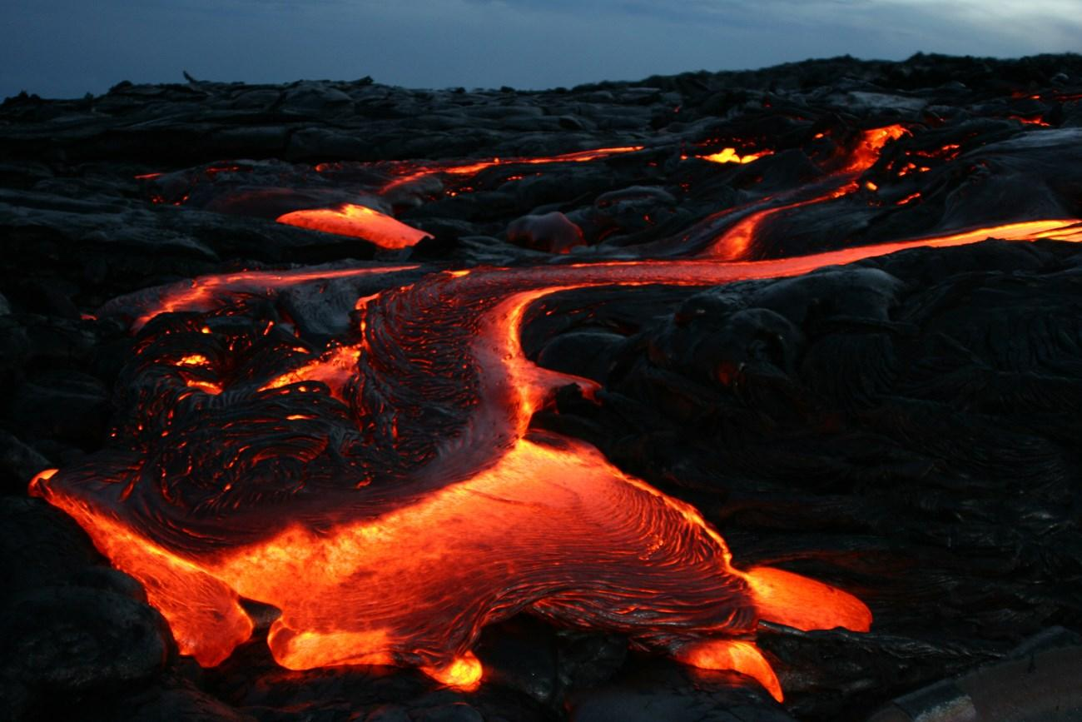
I hope you learned:
Negative/Positive Effects on
economy, people, and environment.

